Slide 1
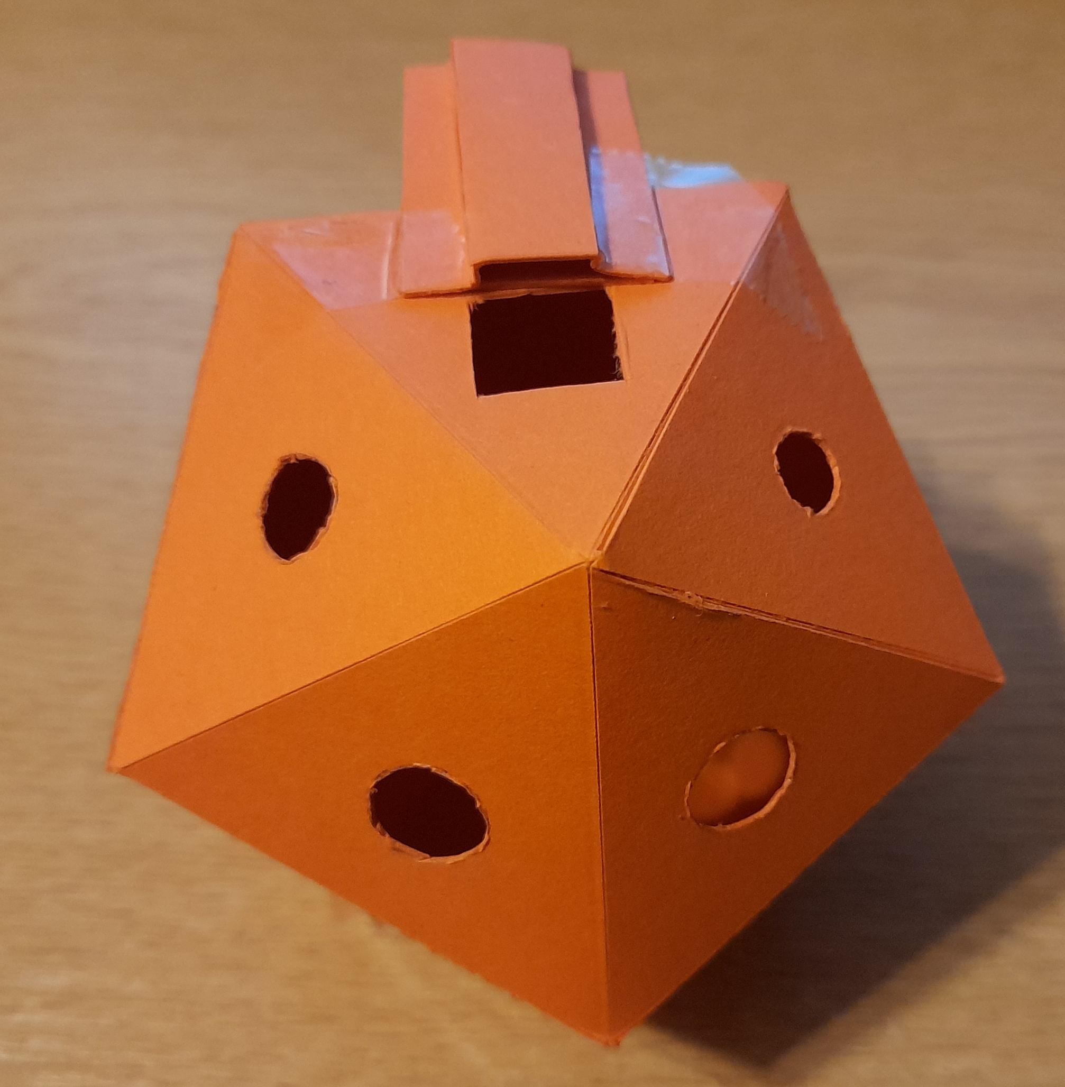
Icosahedral
Ocarinas

Slide 2
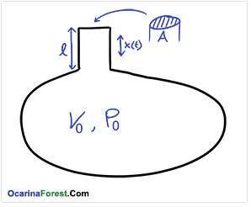





The Ocarina Equation
Frequency: $f=\frac{c}{2π}\sqrt{\frac{A}{Vl}}$
$c$ = speed of sound
$A$ = area of mouth hole
$V$ = volume of chamber
$l$ = length of windway

Slide 3
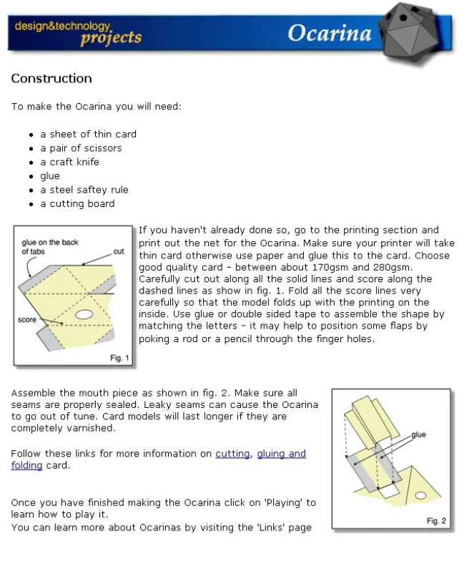
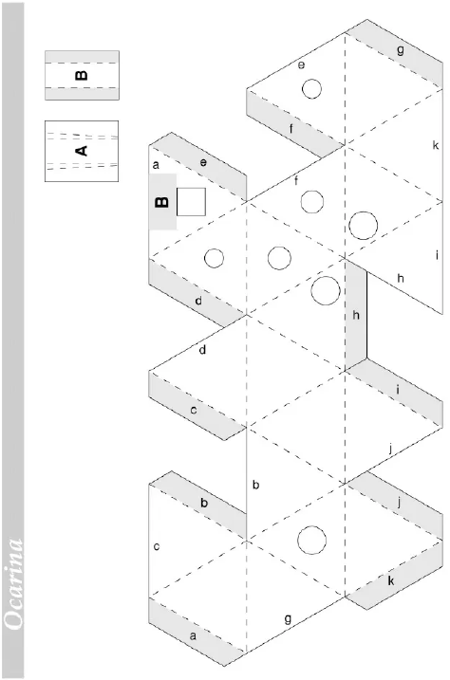
Source: Unknown

Slide 4
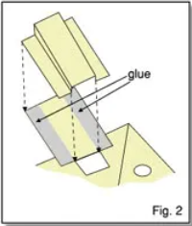


Slide 5
What’s next...?

Slide 6
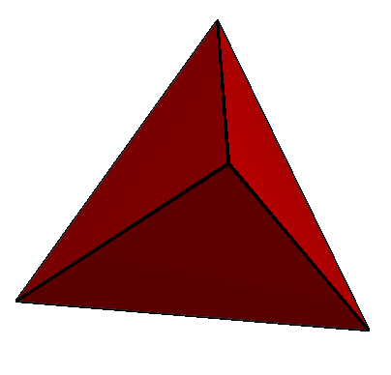

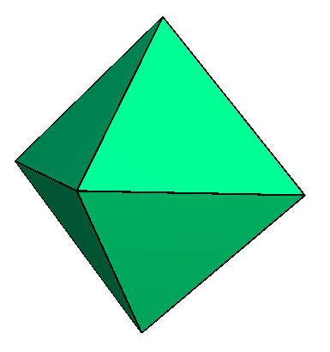
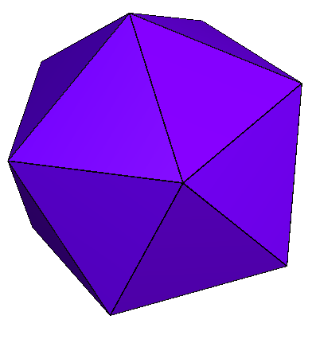

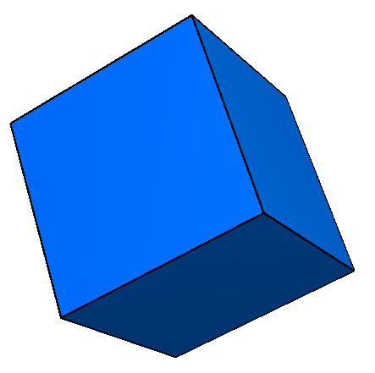

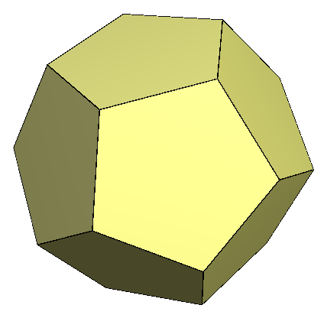
Pentatonic Platonics!

